Slide 1
Emigranti, profughi e diritto d’asilo

Slide 2
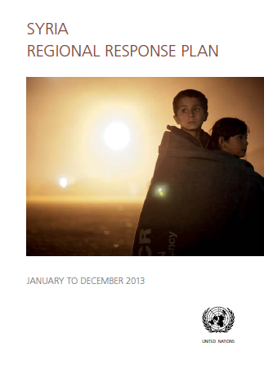

Slide 3
Conflitti 2005
Armenia-Nagorno Karabakh
Cecenia
Iran-Kurdistan-Turchia
Iraq
Palestina
Afghanistan
Kashmir
Filippine-Fronte di liberazione del popolo
Indonesia-Aceh
Thailandia-Patani
Sri Lanka-Tamil
Algeria-Fronte islamico di salvezza
Angola
Burundi-Fronte di liberazione Hutu
Repubblica centrafricana-militari
Ciad-Unione per la libertà
Etiopia-Oromo Liberation Front
Sudan

Slide 4
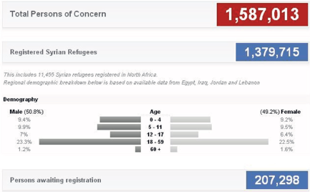
su 20 milioni (7,5%)

Slide 5
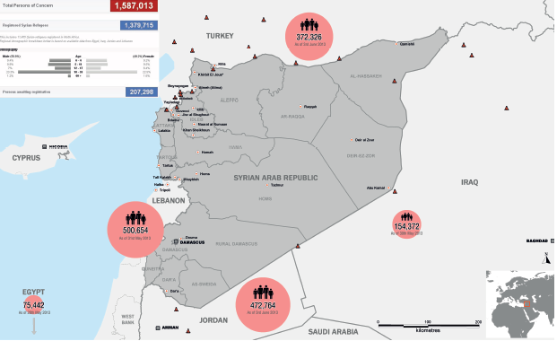

Slide 6
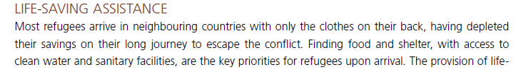
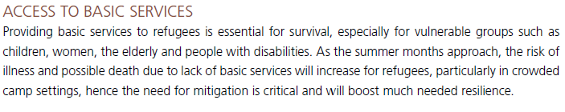
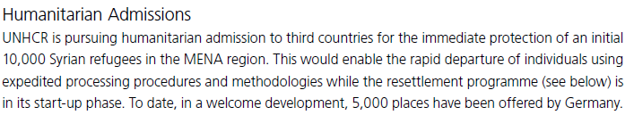

Slide 7
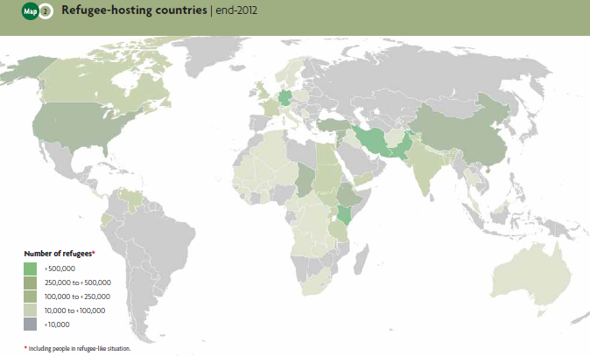

Slide 8

Universal Declaration of Human Rights
1990 Convention of the Protection of the Rights of Migrant Workers: 42 out fo 192 (0 Oecd)

Slide 9
United Nations Convention Relating to the Status of Refugees (1951)
article 1A
"owing to a well-founded fear of being persecuted for reasons of race, religion, nationality, membership of a particular social group, or political opinion, is outside the country of his nationality, and is unable to or, owing to such fear, is unwilling to avail himself of the protection of that country"
Notes:
J.Passel, New Estimates of the Undocumented Population in the United States, Migration Policy Institute, Washington D.C. 2002 (www.migrationinformation.org)

Slide 10
- UN Relief and Welfare Agency (Palestinans of Middle East, c.4 mls)

Slide 11
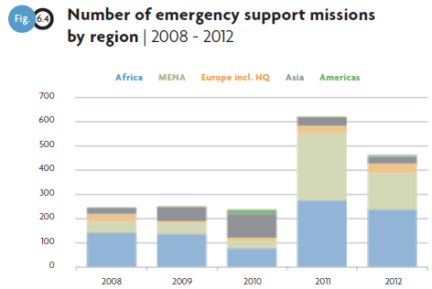

Slide 12
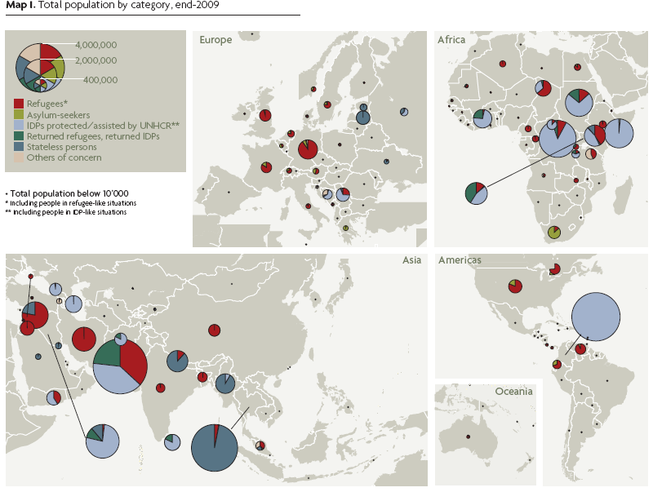

Slide 13
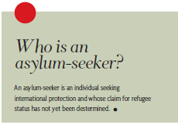

Slide 14
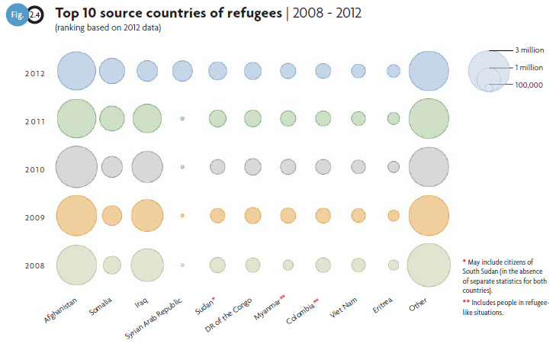

Slide 16
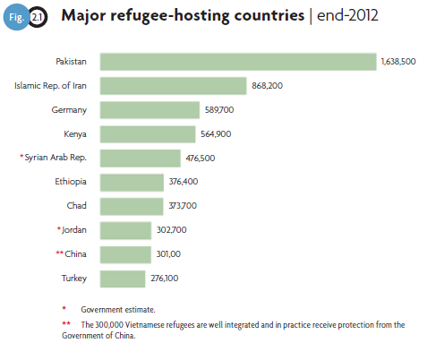

Slide 17
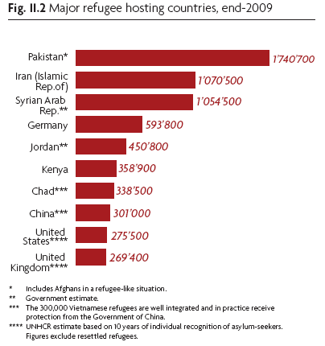

Slide 18
2001

Slide 20
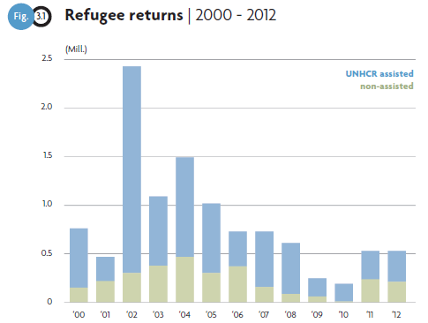

Slide 25
Variabili della globalizzazione (yearly mean rate of growth)
Export mondiale 1973-1998: +5%
Foreign Direct Investments 1986-2000: + 31%
Stock of foreign-born population 1965-2000: 1,2%-2,6%
(nat. demo increase: 1,3%-2%)
Countries with anti-immigration policies: 10 in 1976, 78 in 2000
29 Ocse countries: 12 with reduction-policies, 16 with stabilization-policies (Iceland: no policy)

Slide 26
